Slide 1
Meeting with IABC( Feb 8 @11 a.m.)
By Bulbul Arora, Xia Hua, Li Pan

Slide 2
Needs/ Opportunities
Clearly highlight the advantages of joining IABC and the different memberships.
Make the backend easy to use so it is more manageable and less time consuming.
Easy navigation on the website so people can look for information faster and easily.
A method for taking payments on the website( for job postings, events etc.)
Redirect people to information that can be found at the international website.
Set up 2-way communication from the board to the members and vice versa( blogs, presentations.)
Let members post stories, blogs etc easily and directly on the website.
A sign up/ sign in option where members can easily track their events, accreditations etc.
Create an option where employers can post jobs themselves.
Notes:
Presented by Bulbul

Slide 3
Target Customers
Communications Professionals(Members):
Student/Entry Level: These users want to join IABC to add accreditations to their resumes and build connections to find jobs.
Medium level- These users are looking for connections/ opportunities to expose them to leadership roles/experience and also to maintain their accreditations.
Senior level- These users are willing to give back to the community by offering their experience and guidance to entry/medium level professionals.
Organizations who are looking for professionals in communications/ organizations who are going to sponsor events or make donations.
Notes:
Li

Slide 4
Carryover Customers
These are customers who are necessarily not our targeted customers but are customers who might still benefit from the website.
Communicators who are not a part of the regina chapter but might be looking for knowledge/ guidance that IABC may offer(potential members.)
People looking to gain information on pursuing communications as a profession.
Notes:
Li

Slide 5
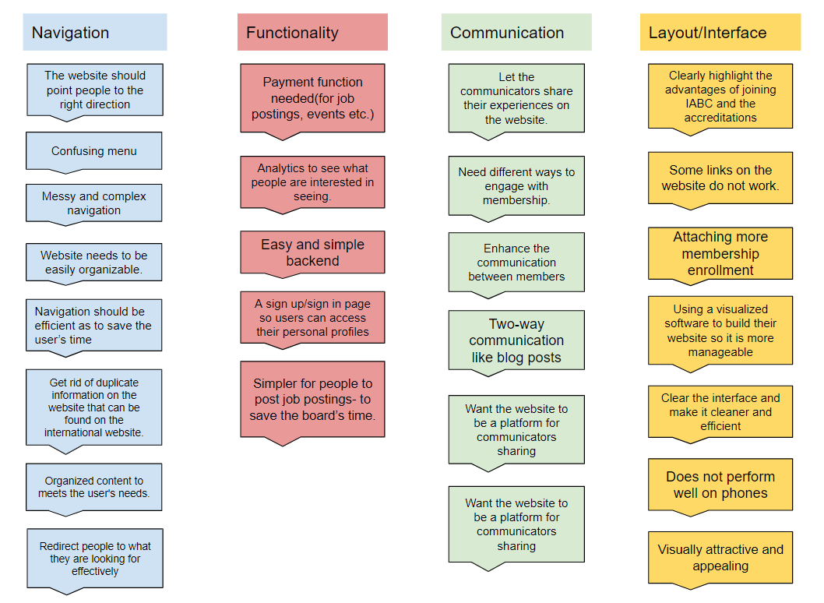
Affinity Diagram - Categories of importance
Notes:
Bulbul

Slide 6
User Story Maps
https://landofooo.storiesonboard.com/m/geonosians
Notes:
Xia

